Slide 1
Process Data Flow Concept

Slide 2
Specifications
 | Process Specifications:
S.No. | Specs | Min | Max
1 | Heater Temp | 50 | 60
2 | Load | 5 | 10
3 | X | 1 | 2
4 | Y | 3 | 4
5 | Z | 5 | 6
6 | ø | 7 | 8

Slide 3
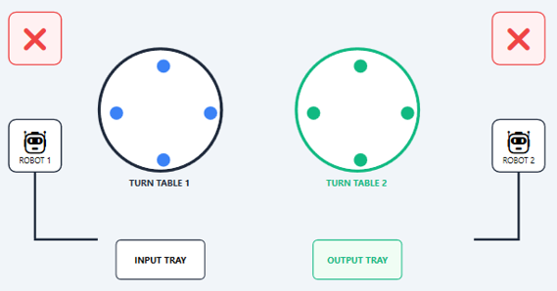
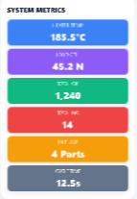
Process Data Flow
4
LOT | QR code | Heater Temp Bend 1 | Heater Temp Bend 2 | Heater Temp Bend 3 | Load Bend 1 | Load Bend 2 | Load Bend 3 | X | Y | Z | ø | Result
 |  | Specs: Min 50 - Max 60 |  |  | Specs: Min 5 - Max 10 |  |  | >1 - <2 | >3 - <4 | >5 - <6 | >7 - <8
2 | ABCD12345A005 | 55 | 55 | 55 | 7 | 7 | 5
 | ABCD12345A006 | 57 | 57 | 57 | 6 | 6 | 6
 | ABCD12345A007 | 56 | 56 | 56 | 8 | 8 | 4
 | ABCD12345A008 | 56 | 56 | 56 | 7 | 7 | 7
1 | ABCD12345A001 | 57 | 57 | 57 | 7 | 7 | 7 | 1.6 | 3.4 | 5.4 | 7.5 | OK
 | ABCD12345A002 | 56 | 56 | 56 | 6 | 6 | 6 | 1.4 | 3.5 | 5.6 | 7.6 | OK
 | ABCD12345A003 | 55 | 55 | 55 | 8 | 8 | 8 | 1.6 | 3.6 | 5.5 | 7.7 | OK
 | ABCD12345A004 | 55 | 55 | 55 | 7 | 7 | 7 | 1.5 | 3.4 | 5.5 | 8.2 | NG
Second lot scanned.
Move to 3
3
First lot scanned
PID | Heater
S.No. | Bend 1 | Bend 2 | Bend 3
1 | xx.xx | xx.xx | xx.xx
2 | xx.xx | xx.xx | xx.xx
3 | xx.xx | xx.xx | xx.xx
4 | xx.xx | xx.xx | xx.xx
2
Third lot scanned.
Move to 4
Lot | Part at Bend-1/2
3 | ABCD12345A009
 | ABCD12345A010
 | ABCD12345A011
 | ABCD12345A012
1
New lot scanned.
Move to 2
Lot | New QR Code Scanned
4 | ABCD12345A013
 | ABCD12345A014
 | ABCD12345A015
 | ABCD12345A016

